Slide 1

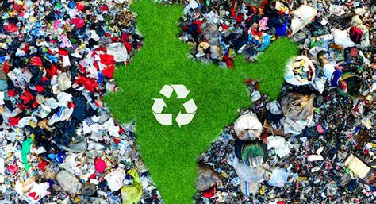
Analyze the steps taken by a Municipal Corporation to create an effective waste management system.
-Rishav –RA2411030010226
- Shaik Sameer – RA2411030010227
- Yazinban – RA2411030010228
- Yashwanth Teja – RA2411030010229
-Awanish Kumar – RA2411030010230
-Vivek Vardhan – RA2411030010231
- Charan Raju - RA2411030010232
- Abhijit Shina – RA2411030010233

Slide 2
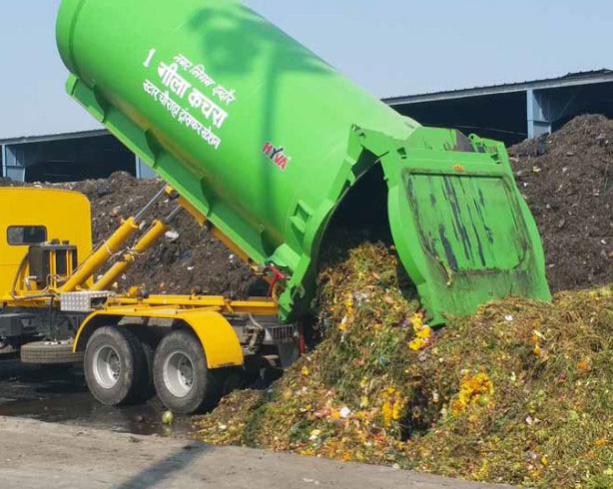
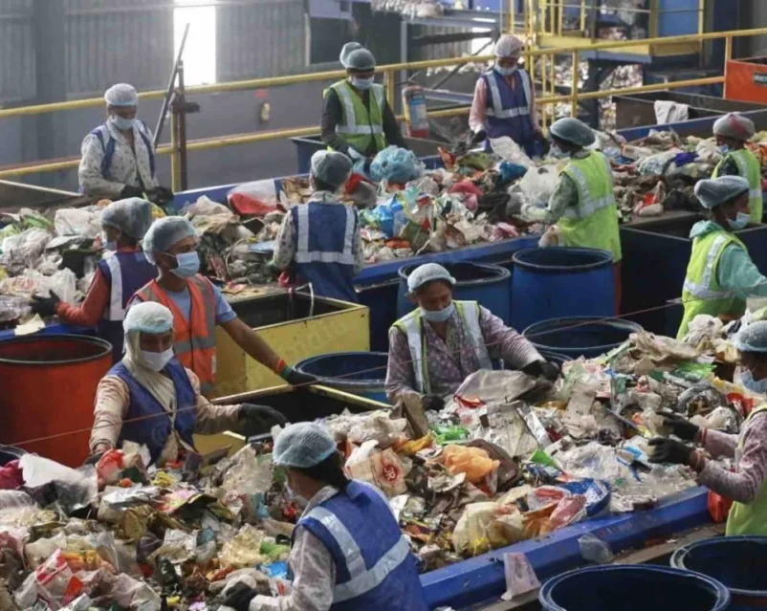
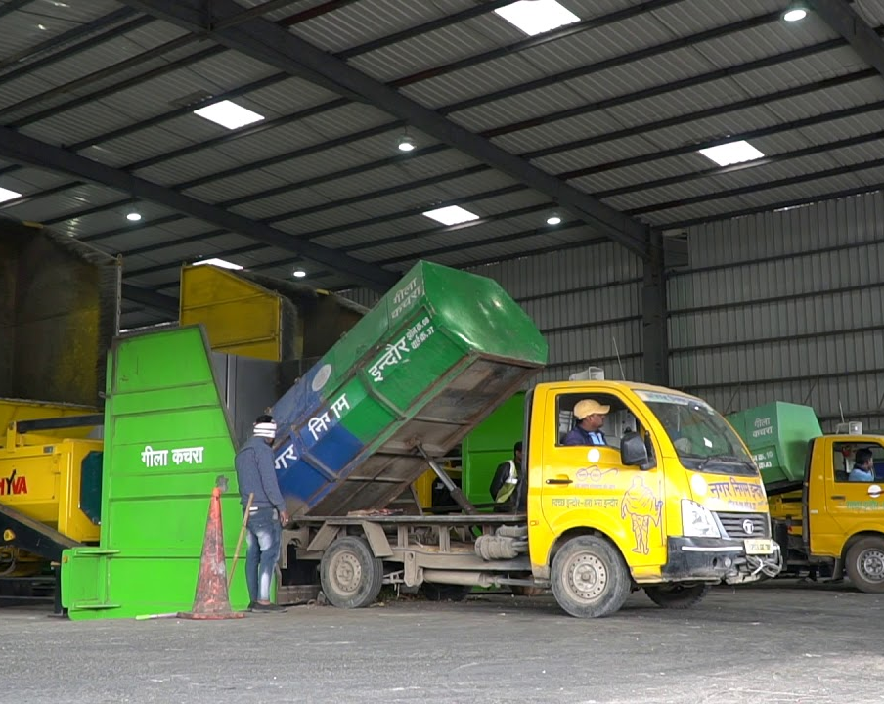
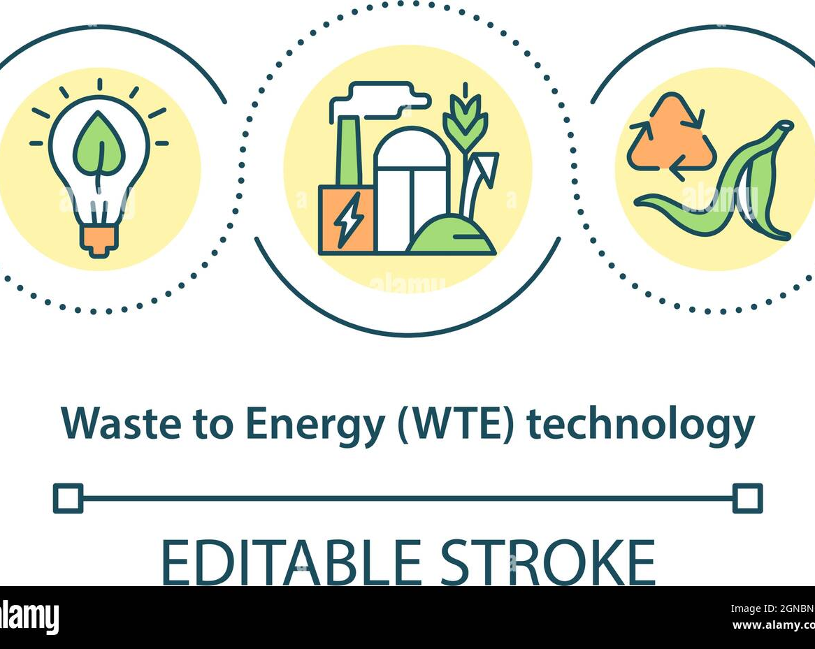
Agenda
1. Introduction to Waste Management
2. Role of Municipal Corporations in Waste
3. Legal Framework and Policies on Waste Management
4. Waste Collection and Segregation Strategies
5. Processing and Disposal of Waste
6. Public Participation and Awareness
7. Challenges Faced by Municipal Corporations
8. Innovations and Best Practices in Waste Management

Slide 3
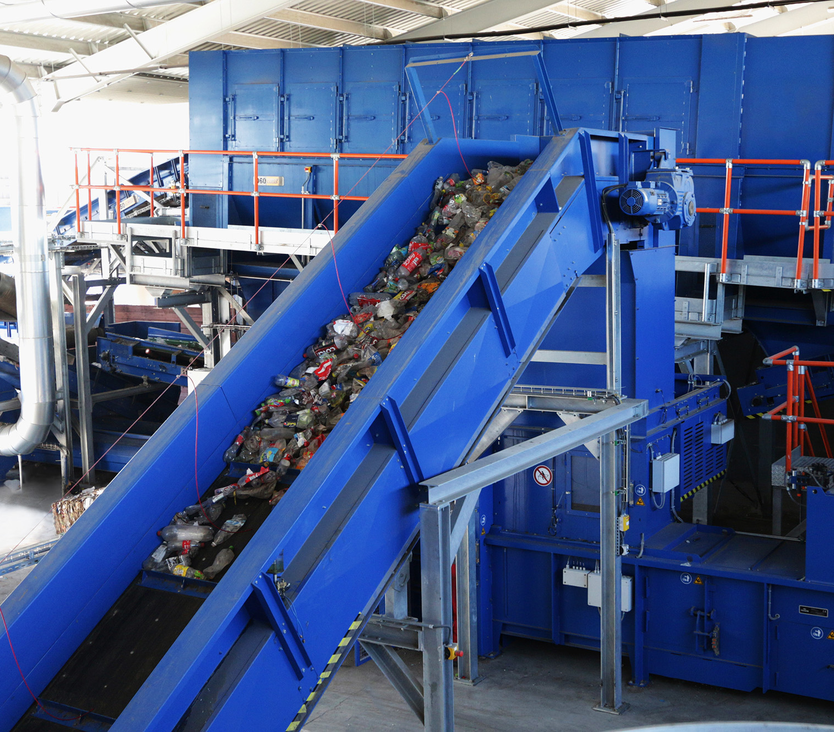
Introduction
Abhijit shina
RA2411030010233

Slide 4

Waste Management: Essential for a Healthy Planet
What is Waste Management?
Collection, recycling, and safe disposal of Waste. Aims to protect health and the Environment. Covers solid, liquid, and gaseous waste from homes and industries..
Why is it Important ?
Environmental Protection: Prevents pollution of air, water, and soil.
Public Health: Reduces disease by controlling pests.
Resource Conservation: Saves materials by promoting recycling.
Sustainable Development: Supports a circular economy and cleaner communities.

Slide 5
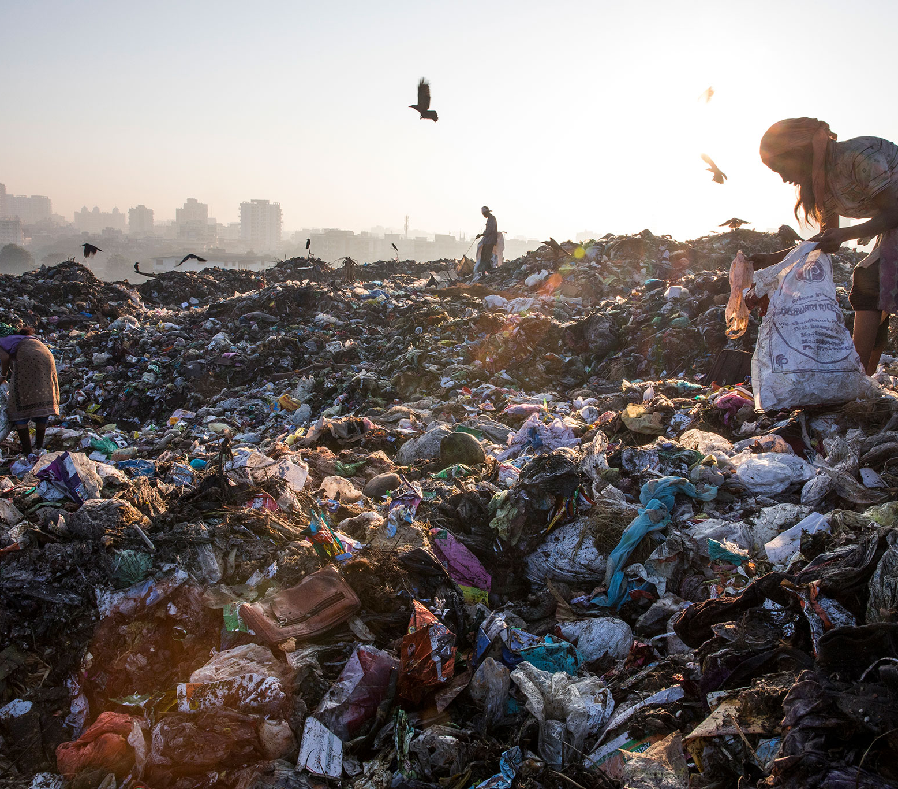
Legal Framework and Policies on Waste Management
By Yazhinban (228)

Slide 6
India has a structured legal framework for waste management, focusing on regulation, recycling, and sustainable disposal.
1. Solid Waste Management Rules, 2016
2. Plastic Waste Management Rules, 2016
3. E-Waste Management Rules, 2016
Applies to urban areas, industries, airports, and railway stations.
Segregation at Source: Biodegradable, non-biodegradable, and hazardous waste.
User Fees & EPR: Waste generators pay collection fees; producers manage waste recovery.
Waste-to-Energy Promotion: Encourages composting, biomethanation, and incineration.
Ban on Open Burning of waste.
Ban on Thin Plastic Bags (less than 75 microns, later 120 microns).
Extended Producer Responsibility (EPR): Brands must collect & recycle plastic waste.
Segregation & Collection: Local bodies must set up plastic waste collection systems.
Use in Road Construction & Recycling encouraged.
EPR & Take-Back Systems: Producers must collect & recycle e-waste.
Authorized Recyclers Only: Unregistered handling is illegal.
Restriction of Hazardous Substances (RoHS): Limits lead, mercury, and cadmium in electronics.

Slide 7
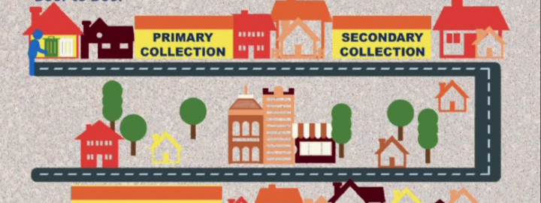
4. Waste Collection and Segregation Strategies
By Sammer (227)

Slide 8
*Waste Collection and Segregation Strategies*
Door-to-Door Collection:
Segregation of Waste:
Role of Waste Collectors:
Ensures efficient waste collection directly from households/businesses.
Reduces street litter and improper disposal.
Timely and organized collection system.
Biodegradable: Food scraps, organic waste – composting reduces landfill use.
Non-biodegradable*: Plastics, glass, metals – recycling reduces raw material use.
Formal Sector: Local government waste services.
Informal Sector (Ragpickers): Critical role in material recovery and recycling.
Integration of both sectors is essential for effective waste management.

Slide 9
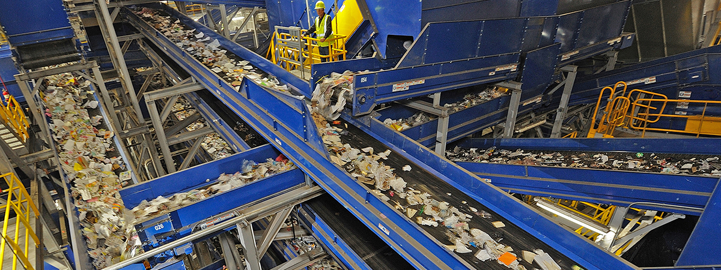
5. Processing and Disposal of Waste
By Viveka Vardhan (231)

Slide 10
Processing and Disposal of Waste
Effective waste management is essential for environmental sustainability. Composting and biogas production utilize organic waste efficiently—composting converts biodegradable materials into nutrient-rich soil, while biogas production generates renewable energy from decomposing organic matter. Recycling and waste-to-energy (WTE) plants help reduce landfill waste—recycling transforms materials like plastic, glass, and metal into new products, while WTE plants convert non-recyclable waste into electricity and heat. Sanitary landfills vs. open dumping highlights the need for controlled waste disposal—sanitary landfills are engineered to prevent pollution, whereas open dumping leads to severe environmental and health hazards. Implementing sustainable waste processing methods is crucial for a cleaner and greener future.

Slide 11
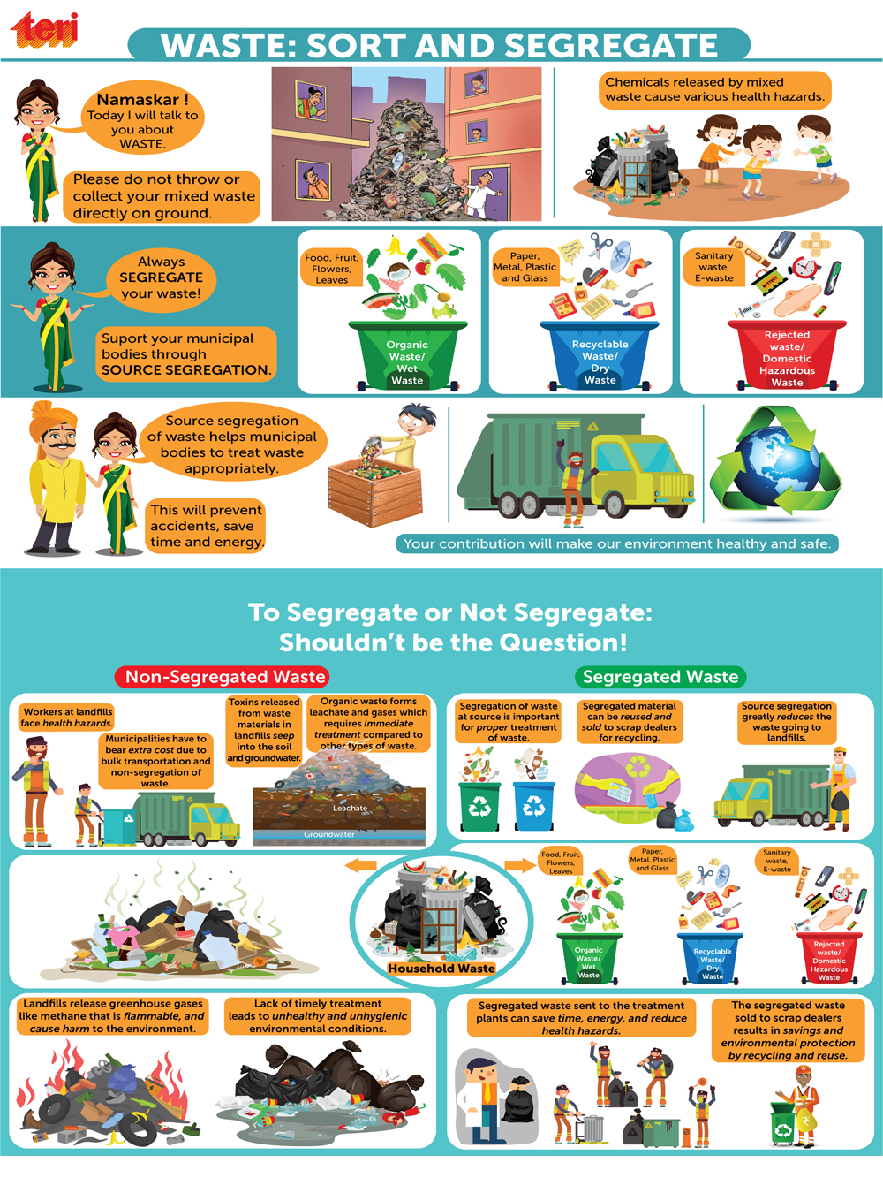
6. Public Participation and Awareness
By Charan Raju (232)

Slide 12
Public participation and awareness in waste management is indeed crucial for maintaining cleanliness and ensuring sustainable practices. You’ve covered some key aspects that contribute to effective waste management. Here's a summarized version for better clarity:
1.Citizen Responsibilities in Waste Management:
2.Government Initiatives – Swachh Bharat Mission:
Waste Segregation at Source: Separate dry, wet, and hazardous waste before disposal.
Reduce, Reuse, Recycle (3Rs): Minimize waste by reusing and recycling materials like paper, plastic, and glass.
Proper Disposal of Hazardous Waste*: Ensure safe disposal of e-waste, batteries, and chemicals to prevent pollution.
Avoiding Single-Use Plastic: Opt for eco-friendly alternatives like cloth bags, steel straws, and biodegradable packaging.
Participating in Cleanliness Drives: Volunteer in local and national initiatives to keep public spaces clean.
Composting Organic Waste: Reduce landfill waste by composting kitchen scraps at home.
Reporting Violations: Inform local authorities about illegal dumping, open burning of waste, or poor waste management practices.
Construction of Toilets: Reduce open defecation by building millions of household and public toilets.
Door-to-Door Waste Collection: Encourage urban and rural local bodies to implement proper waste collection systems.
Solid Waste Management (SWM) Policies*: Establish guidelines for waste segregation, recycling, and disposal.
Encouraging Public Participation*: Engage citizens through awareness campaigns like "Swachh Survekshan" and social media initiatives.
Promoting Waste-to-Wealth: Support innovative waste management techniques like biogas plants and waste-to-energy projects.

Slide 13
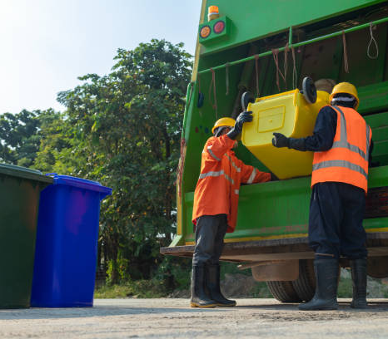
7. Challenges Faced by Municipal Corporations
By Yaswanth Teja (229)

Slide 14
Challenges Faced by Municipal Corporations
2. Public Non-Cooperation and Lack of Awareness
3. Issues with Enforcement of Waste Management Laws
1. Lack of Funds and Infrastructure
(i)Insufficient revenue generation from taxes and fees.
(ii)Dependence on state and central government grants.
(iii)Inadequate infrastructure for water supply, sewage, and transportation.
(i)Resistance to paying municipal taxes and charges.
(ii)Lack of awareness about waste segregation and environmental conservation.
(iii)Encroachments and unauthorized constructions.
(i)Weak implementation of rules due to manpower shortages.
(ii)Inefficient waste collection, segregation, and disposal systems.
(iii)Illegal dumping and lack of citizen participation.

Slide 15
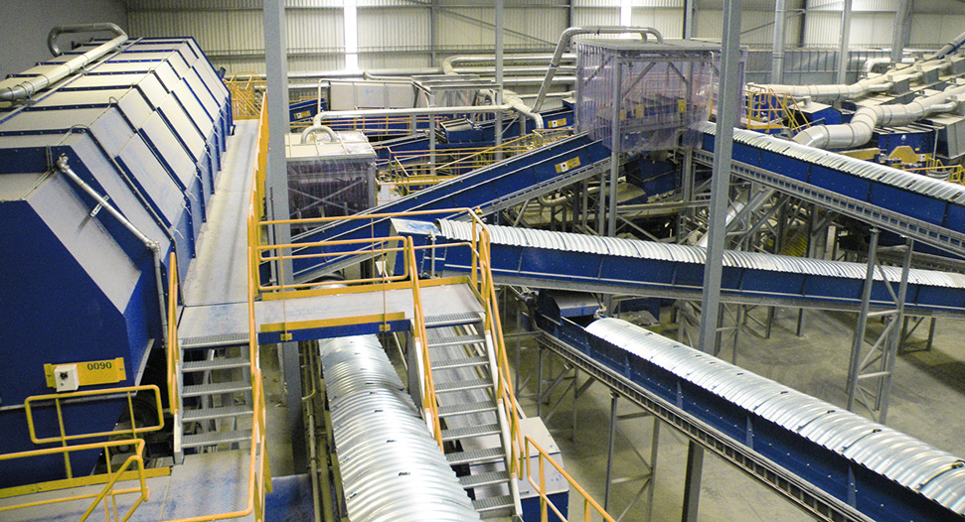
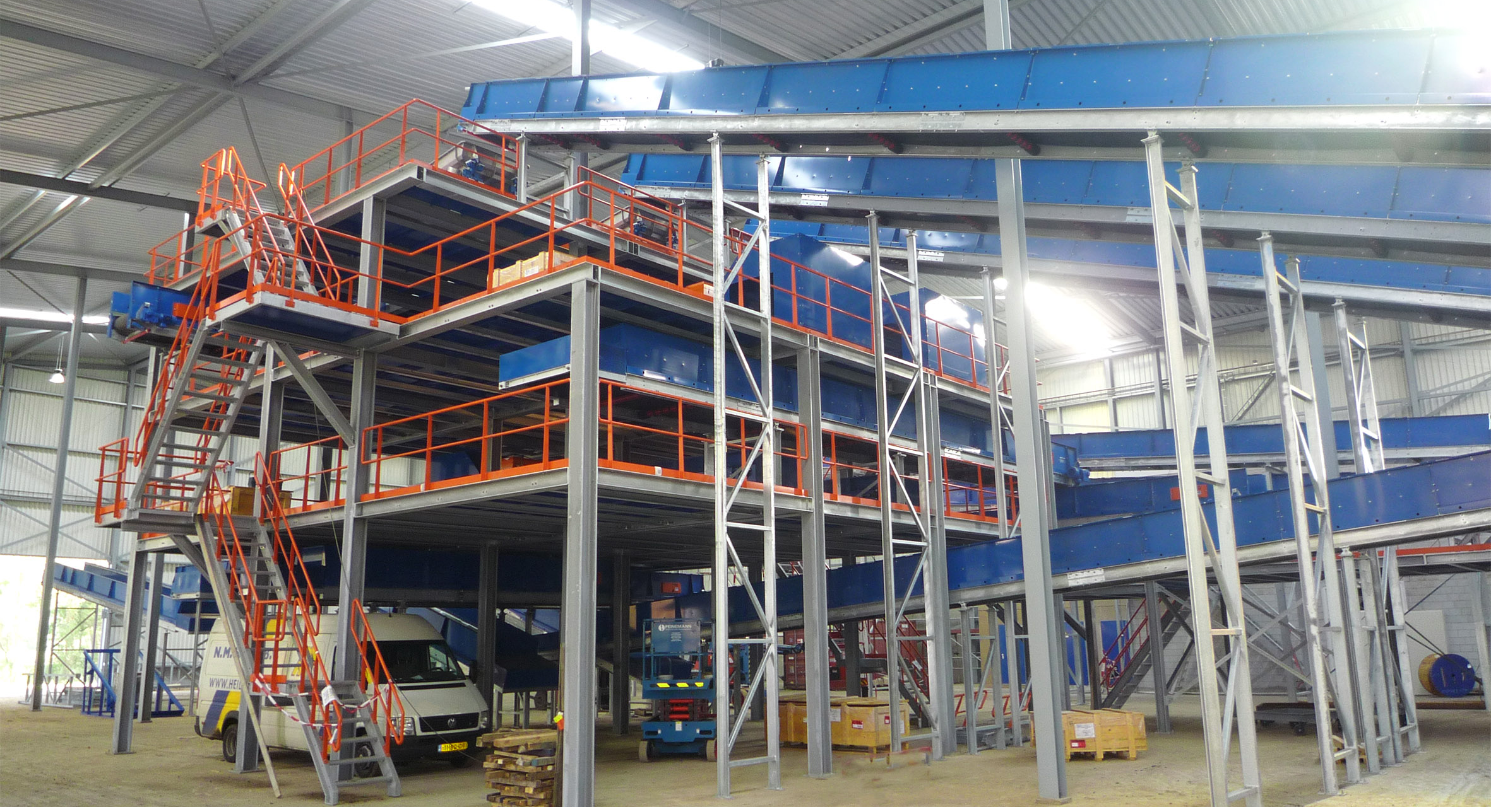
Use of Technology in Waste Management
With One Case Study
-Awanish Kumar
RA2411030010230

Slide 16
7. Innovations and Best Practices in Waste Management
Smart City Initiatives in Waste Management.
Use of technology (GIS mapping, IoT-based waste bins).
Automated Waste Collection
Cities use sensor-based bins to alert authorities when they are full.
Helps in reducing overflowing garbage and improving collection efficiency.
GPS- Enabled Garbage Truck
Live tracking of waste collection routes for better coordination.
Reduces fuel consumption and ensure timely pickup.
Integrated Smart Waste Management Systems
Data-driven waste collection scheduled based on population density
Surveillance cameras to monitor illegal dumping
IoT- based Smart Bins
Equipped with fill- level sensors to optimize collection schedules.
Prevents unnecessary waste pile-ups in public areas
GIS Mapping for Waste Tracking
Helps in mapping landfill sites and planning efficient waste disposal routes.
Reduce environmental hazards by ensuring controlled waste dumping.
AI & Machine Learning in Recycling plants
Automated sorting of waste to improve recycling efficiency.
AI-Powered robot separate plastic, metals and biodegradable waste

Slide 17
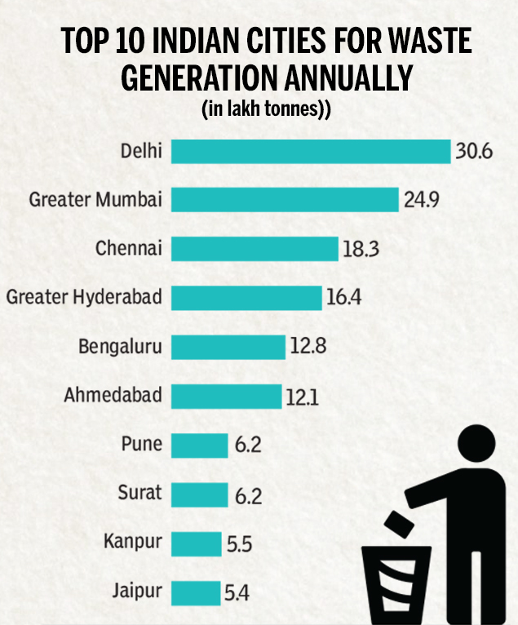
Case studies of cities with effective waste management systems (e.g., Indore, Surat)
Indore – India’s Cleanest City
100% Door-to-Door Waste Collection – No open dumping since 2017.
Waste-to-Compost Plants – Converts organic waste into biogas and manure.
Strict Waste Segregation Rules – Dry & wet waste separation enforced.
Citizen Engagement – Awareness drives under Swachh Bharat Mission.
Surat – Waste-to-Energy Model
Energy from Waste – Converts solid waste into electricity.
Automated Processing Plants – Reduces manual handling of waste.
Sanitation Ranking – Continuously ranks among India’s top clean cities.

Slide 18

Thank you

